Slide 1
PA Amphibians Id practice

Slide 2
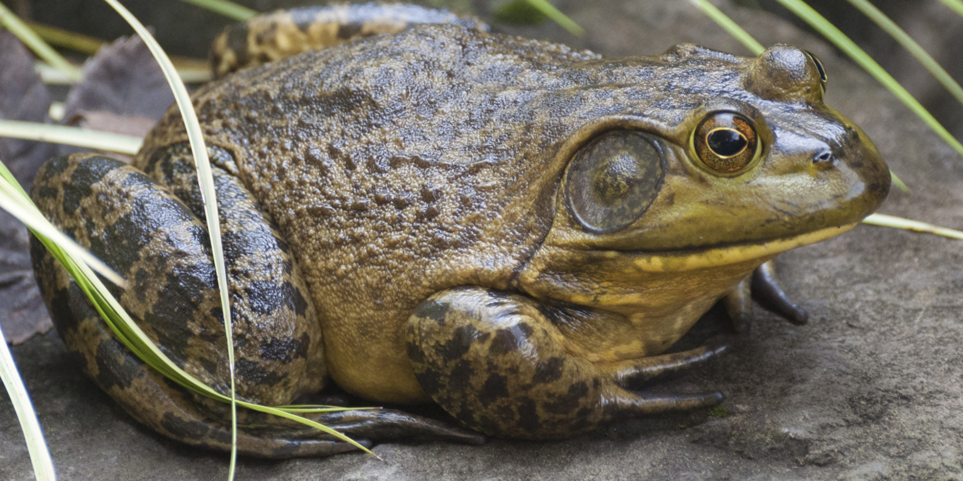
1

Slide 3
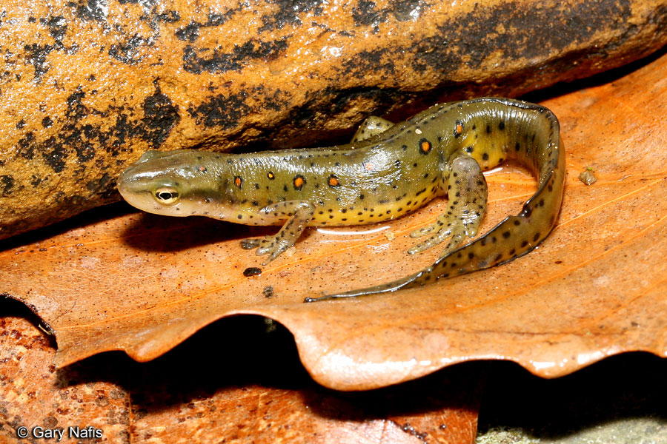
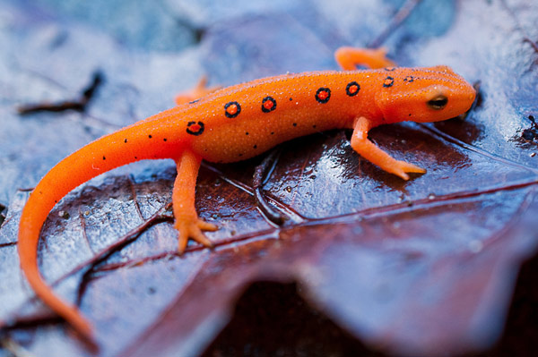
2

Slide 4
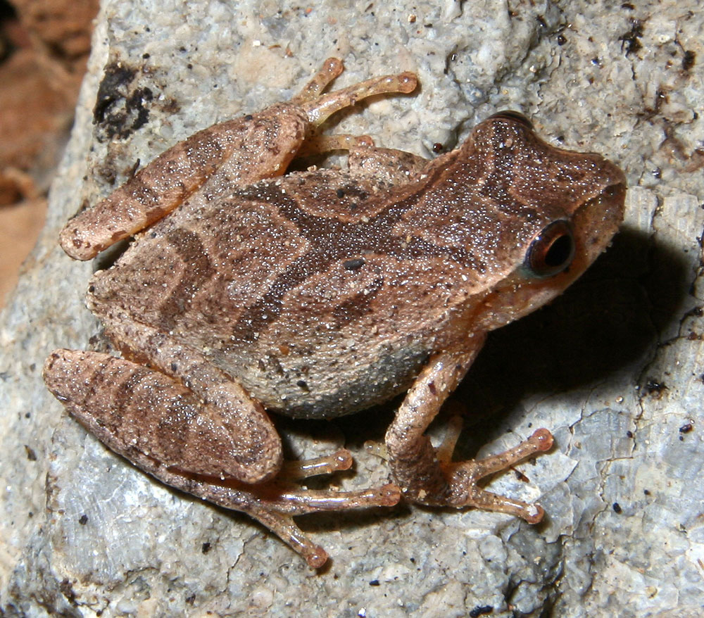
3

Slide 5
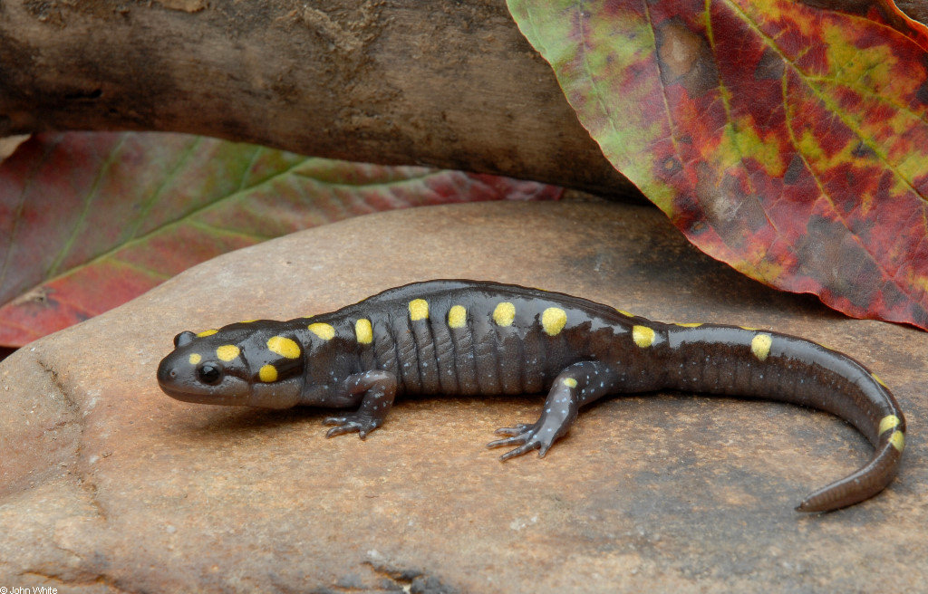
4

Slide 6
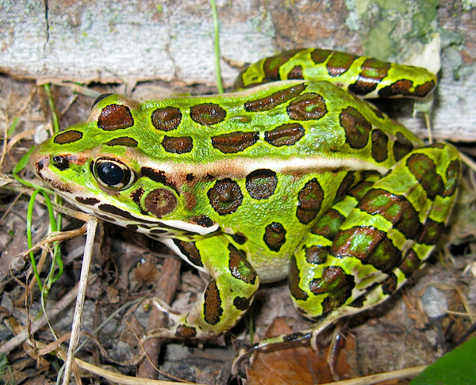
5

Slide 7
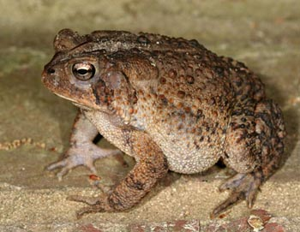
6

Slide 8
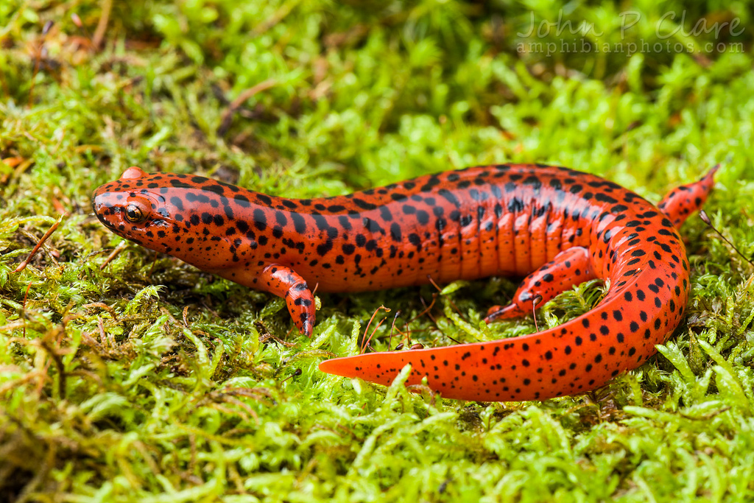
7

Slide 9
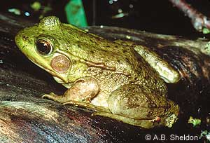
8

Slide 10
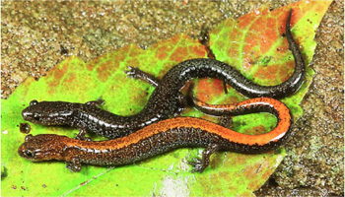
9

Slide 11
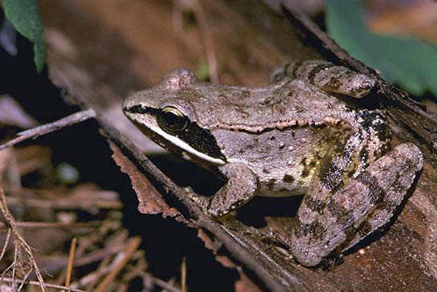
10

Slide 12
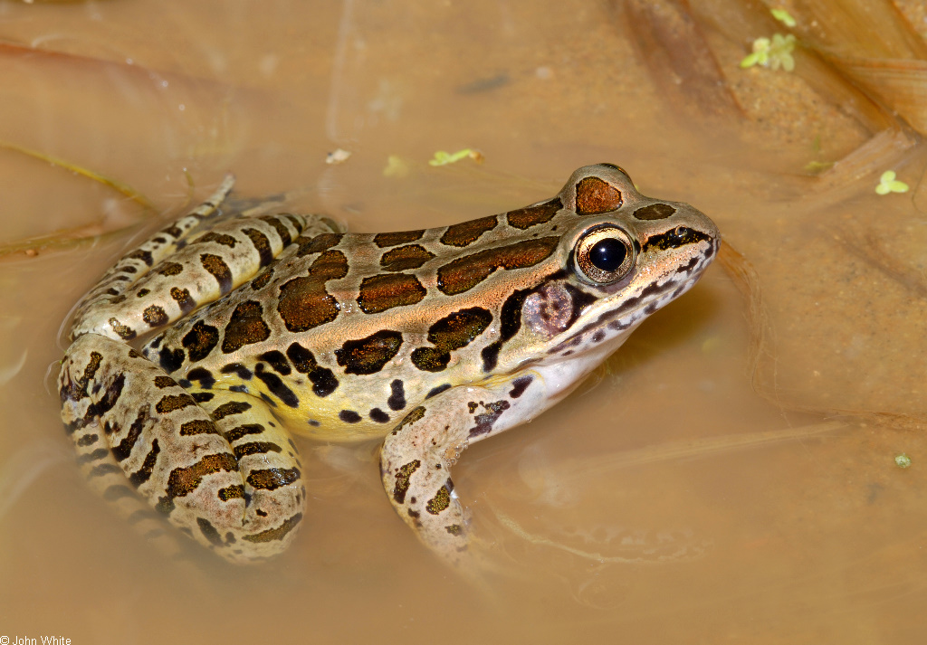
11

Slide 13
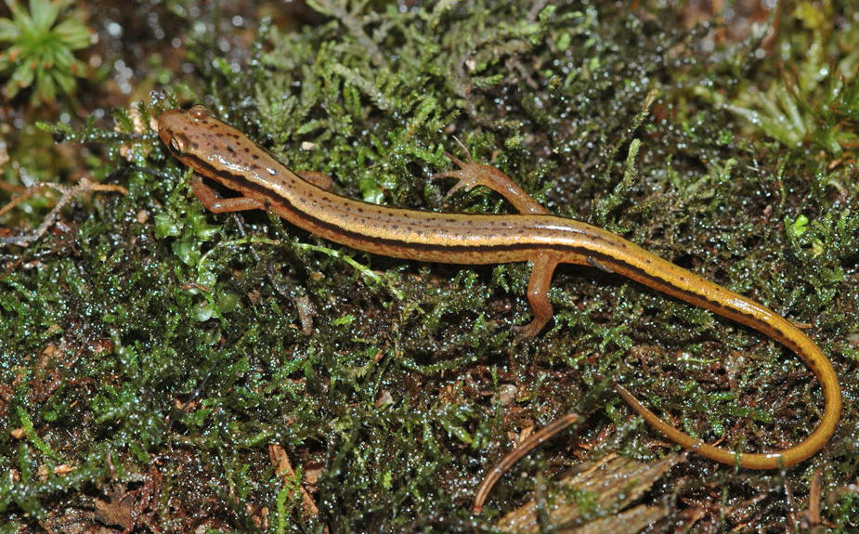
12

Slide 14
Answer Key
1) bullfrog
2) red spotted newt
3) spring peeper
4) spotted salamander
5) N. leopard frog
6) E. American toad
7) N. red salamander
8) green frog
9) red-backed salamander
10) wood frog
11) pickerel frog
12) N. two-lined salamander

